Slide 1
Prioritizing Gaps, Building Action Plans, and Measuring and Monitoring

Slide 2
Identify & Prioritize the ‘Gap’
Should Be – As Is = Gap

Slide 3
Identify & Prioritize the ‘Gap’
Classify gaps
Benefits exceeding costs
Chance to eliminate not shift problems
Low hanging fruit vs. significant changes
Strategic vs. tactical issues
Present ideas to management

Slide 4
Ways to conclude and communicate gaps
Type of Strategy
When to use this strategy
What should be accomplished
·
Workshop
·
Intent is to immediately implement
·
Present proposed changes and resulting
change.
benefits.
·
Participants are motivated and
·
Decide on next steps (goals, timelines,
bought into the idea of change.
and accountable roles).
·
Focus Group
·
Implementation not immediate.
·
Present proposed changes and resulting
·
Motivation and buy-in are needed.
benefits.
·
Discuss and consider the results and
ramifications of change.
·
Determine next steps (move forward
with implementation or not).
·
Formal Presentation
·
Implementation not immediate.
·
Debrief project accomplishments.
·
Motivation and buy-in are needed.
·
Present proposed changes and resulting
·
A later date for focus group or
benefits.
workshop.
·
Determine next steps (move forward
with implementation or not).
·
Internal Communication
·
Formal documentation of the findings
·
To create awareness that this phase of
and conclusions.
the project has concluded.

Slide 5
Keys to success:
Identify & Prioritize the ‘Gap’
Involve project team members in the process
Don’t over rationalize
Try and quantify the gap, where possible
Consider change management implications

Slide 6
Develop Action Plans & Communicate Results
Develop action plans to implement ideas
Statement of the problem
Statement of the recommendation
Key parties responsible for implementation
Key action steps needed to implement the change
Timing for each step to be concluded
Rewards if successfully implemented, on time
Performance measures in place to monitor progress
Develop a program to manage change
Create the case for change
Define a vision of the future
Conduct a change readiness assessment
Conduct a change leadership workshop
Design the change management plan

Slide 7
Keys to success:
Develop Action Plans & Communicate Results
consider training needs
consider ripple effects on other areas
ensure commitment from management
avoid false starts
don’t over-simplify

Slide 8
Measure & Monitor
create a performance management system
use both outcome and activity measures
ensures measures are balanced across
Cost
Quality
Time
Productivity
Customer Satisfaction

Slide 9
Keys to success: Measure & Monitor
use a small, well-balanced family of measures
have appropriate base lines based on historic data
have appropriate goals and benchmarks to strive for
measure formally, continuously, visually

Slide 10
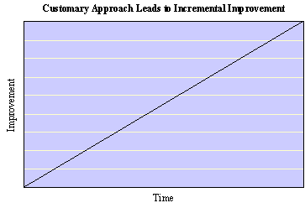
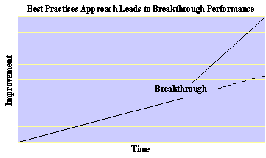
Innovate and Create for best results!!

